Slide 1

Case study – FLIGHT BOOKING SYSTEM
NAME – PALLAVI SRIJA . G
DESIGNATION – Analyst at Capgemini
GRADE – A4

Slide 2
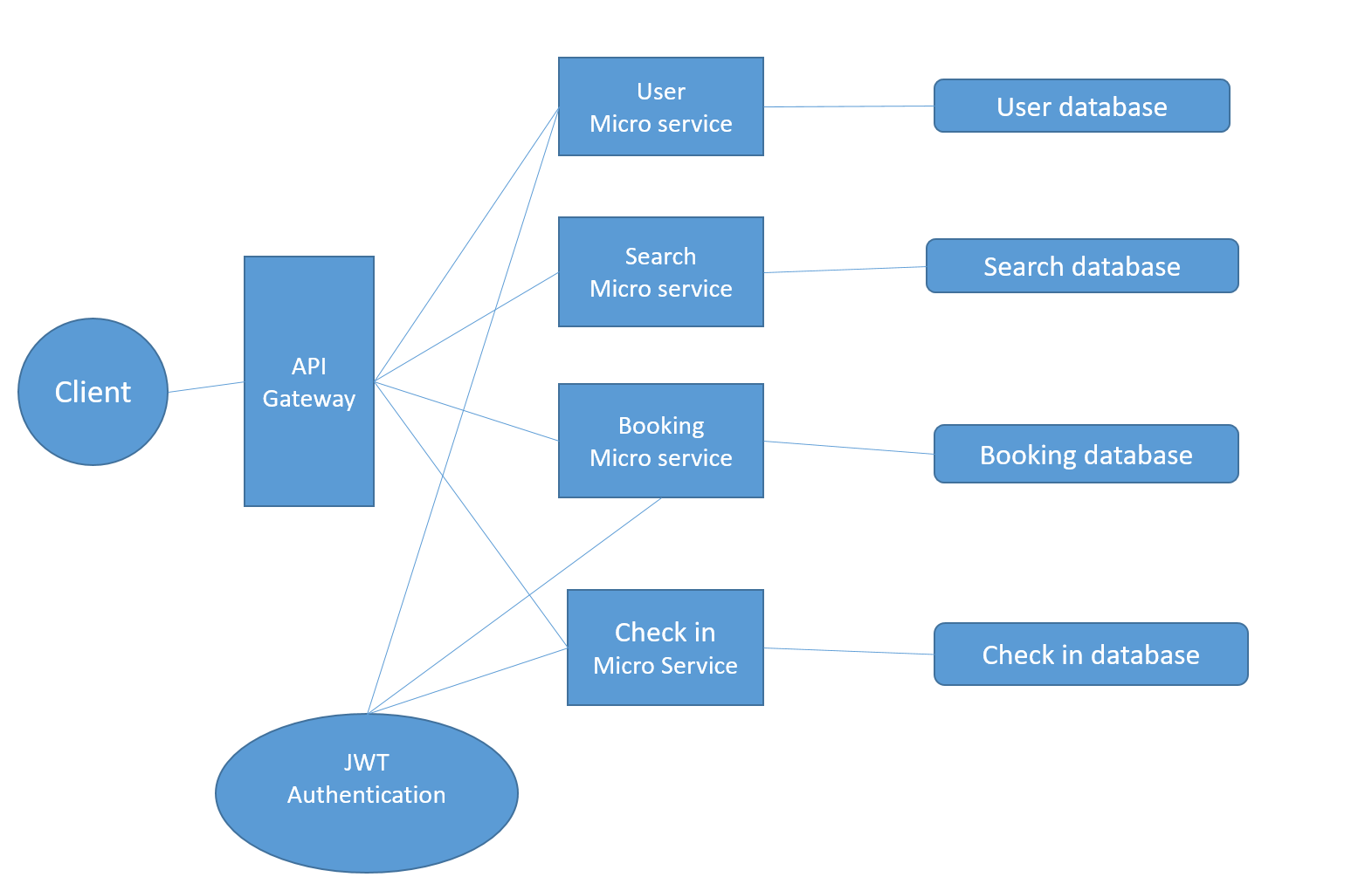

Slide 3
Technologies used
Mongo DB
Express JS
Angular
Node JS
HTML 5 & CSS 3
API Gateway
Mocha & Chai
Karma & Jasmine
Authentication with JWT

Slide 4
MICRO-SERVICES USED
USER MICRO SERVICE
SEARCH MICRO SERVICE
BOOKING MICRO SERVICE
CHECK-IN MICRO SERVICE

Slide 5
VIDEO PRESENTATION
OF CASE STUDY

